Slide 1
THG Simulations
Project update
Week 5
??/08/2023
David Amorim

Slide 2
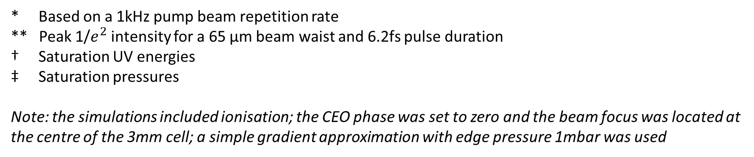
Relative Neon/Argon saturation values
Beam power* | Beam peak intensity** | E_Ne/E_Ar † | P_Ne/P_Ar ‡
75mW | 0.091 PW/cm^2 | 0.945 | 11.591
150mW | 0.182 PW/cm^2 | 2.302 | 11.588
200mW | 0.243 PW/cm^2 | 2.871 | 10.688
300mW | 0.365 PW/cm^2 | 3.376 | 10.143
* Based on a 1kHz pump beam repetition rate
** Peak 1/$e^{2}$ intensity for a 65 µm beam waist and 6.2fs pulse duration
† Saturation UV energies
‡ Saturation pressures
Note: the simulations included ionisation; the CEO phase was set to zero and the beam focus was located at the centre of the 3mm cell; a simple gradient approximation with edge pressure 1mbar was used

Slide 3
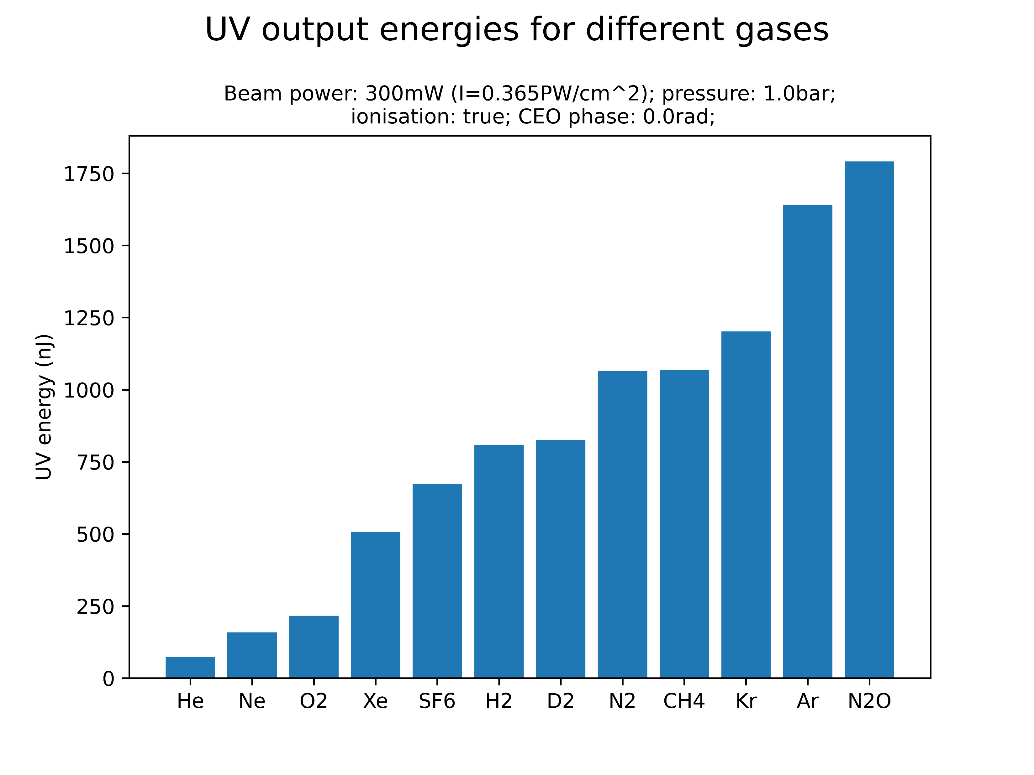
Comparison of different gases

